Slide 1
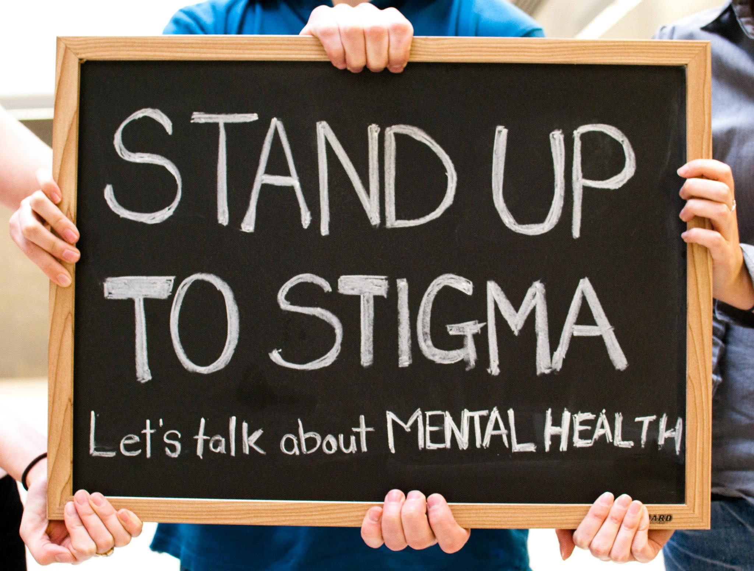
Trauma & Stigma
Western Mass CIT-TTAC

Slide 2
Learning Objectives
Participants will be able to identify to identify stigma and how it affects those living with mental illness
Participants will be able to identify how the brain operates under prolonged stress
Participants will be able to identify trauma response and what they look like
Participants will be able to identify practical approaches to utilize when speaking with someone who is in crisis.

Slide 3
Some Facts and Experiences of those with Mental Illness
Around 60% of adults with a mental health illness don’t receive care – NAMI
It takes on average 11 years from the start of a mental health symptoms to when someone receives treatment
Approximately 68% of women and 57% of men with mental health problems are parents. The most common mental health problems experienced during pregnancy and after birth are anxiety, depression and post-traumatic stress disorder (PTSD). (Mental Health Foundation)
Nearly 50% of all mental illnesses begin in childhood before the age of 14 years, (national institute of health)
More than one in five U.S. adults live with a mental illness (57.8 million in 2021). (NAMI)

Slide 4
STIGMA
Myth: People with mental health conditions are more violent.
Only 3%–5% of violent acts can be attributed to individuals living with a serious mental illness. In fact, people with severe mental illnesses are over 10 times more likely to be victims of a violent crime than the general population
People with lived experience of Mental Illness report stigma as the number one reason for not seeking treatment

Slide 5
Words exercise
Let's have fun! Yell your answers out loud!!!!!!!
Words used to describe someone who has been diagnosed with cancer
Words used to describe someone who has a mental health condition

Slide 6
Trauma Informed Mindset
What is wrong with you
To
What happened to you

Slide 7
Let's Talk About Trauma
What is trauma
The lasting emotional response that results from living through a distressing event
The effect on your brain’s emotional systems to make you over or under react to situations
Anything which has overloaded our neuro and physical system which we haven’t been able to fully process and or metabolize.

Slide 8
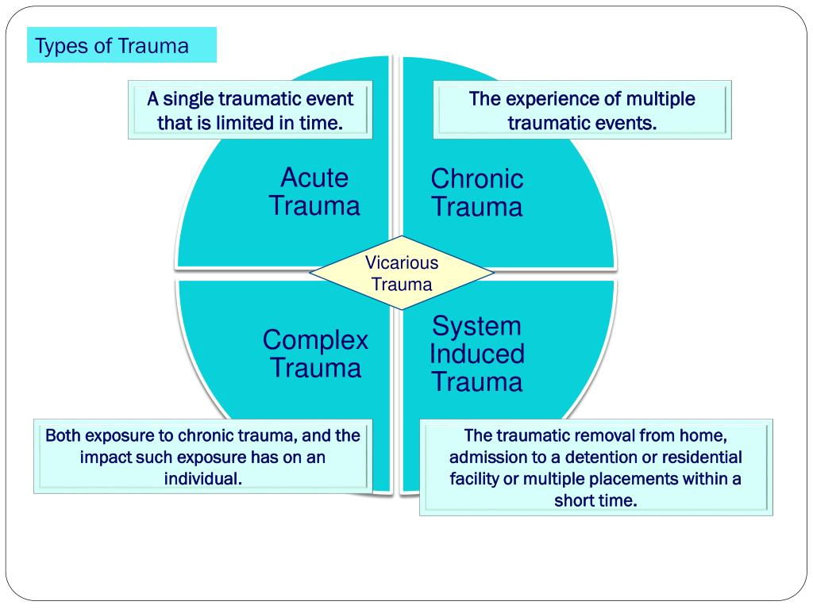
Types of Trauma
Single event/Acute trauma
Car accident
House fires
Mugging
Sexual assault
Chronic Trauma/on-going
War combat
Domestic Violence
Sexual Abuse
Bullying
Complex Trauma/multiple on-going traumas, generally in the context of interpersonal relationships

Slide 9
Some Key Factors to Remember
What is traumatic isn’t always dramatic
Trauma is stored in the emotional center of our brain and in our bodies.
Trauma is not stored in our language and rational/cognition part of our brain
Trauma is not stored in a linear fashion

Slide 10
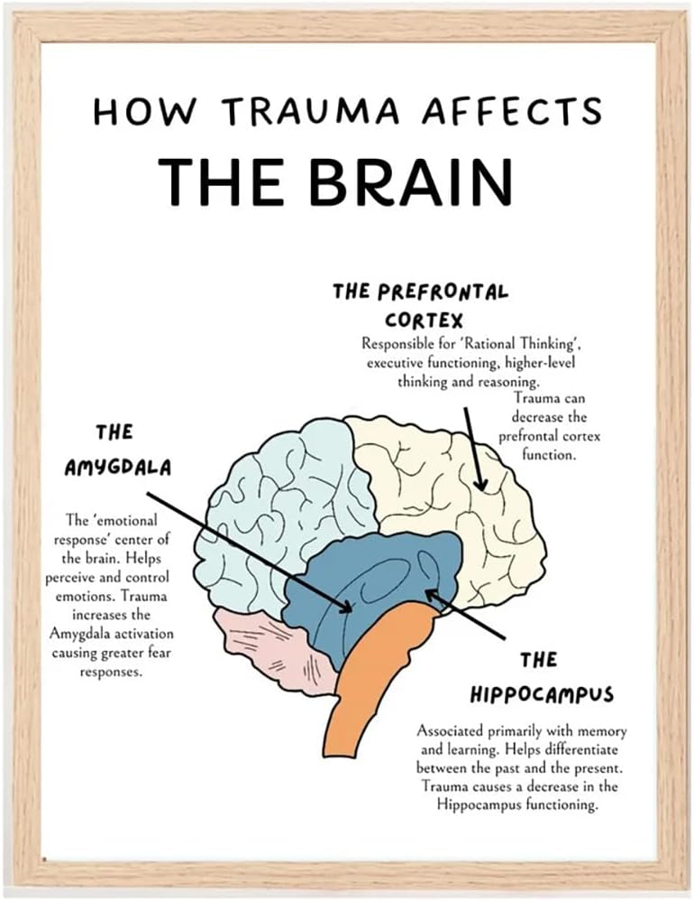

Slide 11
Trauma & Brain Science
Lizard Brain
Brain stem and cerebellum. It operates on instinct and is responsible for the survival-related functions of the of the body. – Think heart rate, body temperature, and fight or flight responses
Mammalian Brain
This is the emotional brain; it is responsible for our emotional and relational experiences.
It is responsible for us feeling drawn towards or away from things and for holding emotional memories of our experiences.
These experiences of shared pleasure or pain are also encoded as nonverbal memories of attachment experiences, laying down templates for expectations of future relationships
Human Brain
This is the frontal cortex, the front structure of our brain.
It contains almost all of our language/communication abilities. This part of the brain processes information in an explicit, direct, logical, analytical, and linear fashion.
This is the part of the brain that is “offline” when someone is experiencing a trauma response.
This part of the brain is not fully developed until around age 25. This is the youngest part of our brain both on an individual and an evolution basis

Slide 12
Abuse and Survival Needs
Physical abuse
Sexual abuse
Emotional/mental abuse
Neglect
Food
Water
Shelter
Sex
Attachment/Connection

Slide 14
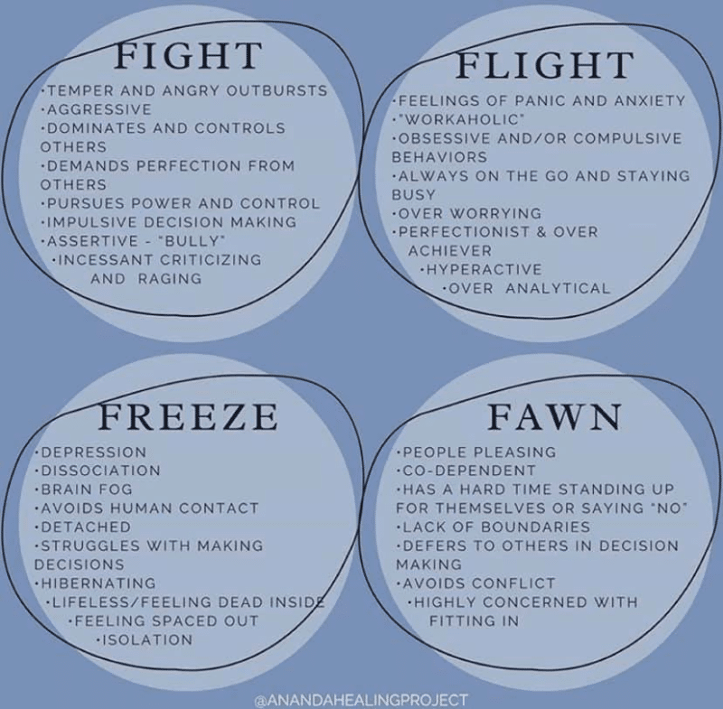
Types of Trauma Responses
Involuntary responses, reactions or behaviors, that one may engage in during times of high and or chronic/toxic stress. These involuntary responses can be from “real” or perceived threats.
Fight –aggression, yelling, sometimes disorganized, communication may feel “all over the place”
Flight – running, avoiding, changing topic of conversation
Freeze – numbing, shutting down, not speaking or answering questions
Appease –overly compliant

Slide 15
Adverse Childhood Experiences (ACE’s)
A household member, insulted, humiliated, or put you down in a way that scared you OR acted in a way that made you afraid that you might be physically hurt
Someone touched your private parts or asked you to touch their private parts in a sexual way that was unwanted, against your will, or made you feel uncomfortable
Someone pushed, grabbed, slapped or threw something at you OR you were hit so hard that you were injured or had marks
You lived with someone who had a problem with drinking/drugs You often felt unsupported, unloved and/or unprotected
You have been in foster care
You have experienced harassment or bullying at school
You have lived with a parent or guardian who died
You have been separated from your primary caregiver through deportation or immigration
More than once, you went without food, clothing, a place to live, or had no one to protect you
You have often seen or heard violence in the neighborhood or in your school neighborhood

